Slide 1

Movies Genres
Survey Project Presentation

Slide 2


Movies Genres
Survey Project Presentation

Slide 3
TABLE OF CONTENTS
01
02
03
Introduction
Questionnaire
Sampling & Pretest
04
05
06
Collecting Data
Expectation Vs. Reality
Data Analysis
01
02
03
04
05
06

Slide 4
01
Introduction
Home
Phase 1
Phase 2
Phase 3
Phase 4
Phase 5
Phase 6
01
we will discuss the methods and steps we went through in each phase
we will discuss the methods and steps we went through in each phase

Slide 5
Introduction
01
Home
Phase 1
Phase 2
Phase 3
Phase 4
Phase 5
Phase 6
01
We conducted a study on movie genres since it's crucial for producers and filmmakers to identify the genres that will draw audiences.
we will discuss the methods and steps we went through in each phase

Slide 6
Budget
Home
Phase 1
Phase 2
Phase 3
Phase 4
Phase 5
Phase 6
Our budget after calculations turned out to be :
0$
Survey responses that show symptoms of inattention or a lack of effort from the participants are referred to as carelessly answered surveys.
These responses could be answering all questions with the same response option, giving answers that are illogical or contradictory, or purposefully failing attention check questions.
We designed attention check questions that ensure the respondent’s attentiveness and the integrity of their responses.

Slide 7

Why the very low budget?
Home
Phase 1
Phase 2
Phase 3
Phase 4
Phase 5
Phase 6
The reason for the low budget is our utilization of Free and Open-Source Software like:
Google form
Python
R
Excel
Tableau
Survey responses that show symptoms of inattention or a lack of effort from the participants are referred to as carelessly answered surveys.
These responses could be answering all questions with the same response option, giving answers that are illogical or contradictory, or purposefully failing attention check questions.
We designed attention check questions that ensure the respondent’s attentiveness and the integrity of their responses.

Slide 8
Questionnaire
Home
Phase 1
Phase 2
Phase 3
Phase 4
Phase 5
Phase 6
Demographic questions
02
We asked about the ID if s/he from our college. We also asked about the major if s/he aren’t which will help us gain insights from there test
Instructions
Talking about the questions
Read the questions attentively and pick wiesly.
He has the choice of answering or not answering the optional questions.
The survey will close on January 5, 2023.

Slide 9
Questionnaire
Home
Phase 1
Phase 2
Phase 3
Phase 4
Phase 5
Phase 6
| Our Questions Area
02
Demographic questions
Several questions were made to help in covering all aspects.
We asked about the ID if s/he from our college. We also asked about the major if s/he isn’t which will help us gain insights from there test
Instructions
Read the questions attentively and pick wisely.
They have the choice of answering or not answering the optional questions.
The survey will close on May 21, 2023.
Optional Questions
The participant is asked whether they have any other comments to contribute at the end of the survey.
Response Option
There are a variety of questions, including multiple-choice, rating scale, checkbox, and open-ended inquiries.

Slide 10
Our Questions Area
Optional Questions
Response Option
Home
Phase 1
Phase 2
Phase 3
Phase 4
Phase 5
Phase 6
Demographic questions
We asked about the ID if s/he from our college. We also asked about the major if s/he aren’t which will help us gain insights from there test
The participant is asked whether they have any other comments to contribute at the end of the survey.
Instructions
Read the questions attentively and pick wiesly.
He has the choice of answering or not answering the optional questions.
The survey will close on January 5, 2023.
There are a variety of questions, including multiple-choice, rating scale, checkbox, and open-ended inquiries.
Main Questions
Survey questions are deliberately created to elicit sorts of replies that might aid researchers in understanding attitudes, views, behaviors and other crucial data relevant to their study objectives.
People may easily comprehend the questions and give accurate, clear answers without making any mistakes.
If he chooses to view films at home or at a theatre, there are two divisions (home section and cinema section).
To determine if a person is responding carelessly or not, there are questions to gauge careless responses.

Slide 11
Our Questions Area
Main Questions
Response Option
Home
Phase 1
Phase 2
Phase 3
Phase 4
Phase 5
Phase 6
Survey questions are deliberately created to elicit sorts of replies that might aid researchers in understanding attitudes, views, behaviors and other crucial data relevant to their study objectives.
People may easily comprehend the questions and give accurate, clear answers without making any mistakes.
If he chooses to view films at home or at a theatre, there are two divisions (home section and cinema section).
To determine if a person is responding carelessly or not, there are questions to gauge careless responses.
Optional Questions
The participant is asked whether they have any other comments to contribute at the end of the survey.
There are a variety of questions, including multiple-choice, rating scale, checkbox, and open-ended inquiries.

Slide 12
WHAT WE DID
Home
Phase 1
Phase 2
Phase 3
Phase 4
Phase 5
Phase 6
Cinema Section
Home Section
MCQ: 15
Rating: 2
Checkbox: 2
Open: 3
MCQ: 10
Rating: 2
Checkbox: 3
Open: 6

Slide 13
Sampling & Pretest
Home
Phase 1
Phase 2
Phase 3
Phase 4
Phase 5
Phase 6
03
Define all necessary components required for completing the sampling process.

Slide 14
Sampling & Pretest
Home
Phase 1
Phase 2
Phase 3
Phase 4
Phase 5
Phase 6
The Modifications
 | Sampling | Pretest
 | We defined the population based on three characterstics Age Gender Location | After researching we will use a sample size of from 5% to 10% Our main group is between 300:400 participants so we have chosen 30 random participants
 | We used Random Sampling to try and gather ~ 400 responses | We will analyze the results obtained and determine any necessary modifications to the questionnaire or study design
We detected vague terms that people didn’t understand
We have changed the ranking questions style by decreasing the number of choices to 5 instead of 8 and we transformed the questions into a matrix in google form, which makes it easier for the participants to answer
One of the most frequently mentioned issues in the feedback was the lack of an option for participants who do not go to the cinema. As a result, we added a new section specifically for those who prefer watching movies at home

Slide 15
The Modifications
Home
Phase 1
Phase 2
Phase 3
Phase 4
Phase 5
Phase 6
We detected vague terms that people didn’t understand
We have changed the ranking questions style by decreasing the number of choices to 5 instead of 8 and we transformed the questions into a matrix in google form, which makes it easier for the participants to answer
One of the most frequently mentioned issues in the feedback was the lack of an option for participants who do not go to the cinema. As a result, we added a new section specifically for those who prefer watching movies at home

Slide 16
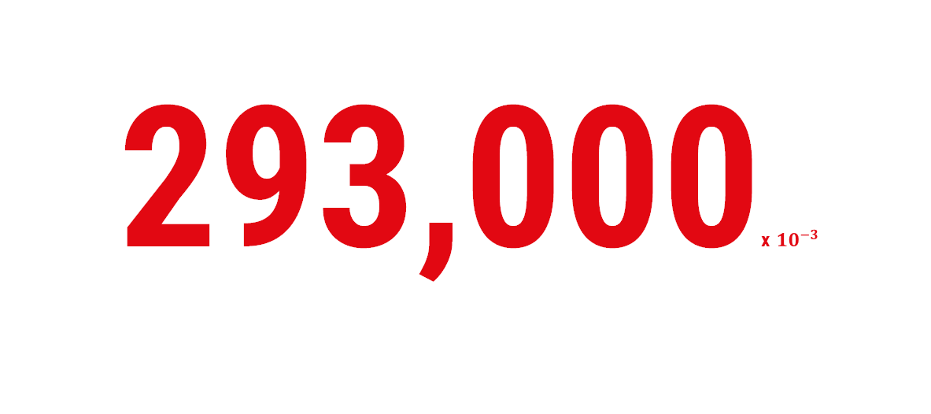
Collecting Data
293,000x $10^{−3}$
Our audience’s attention
Home
Phase 1
Phase 2
Phase 3
Phase 4
Phase 5
Phase 6
04
A clean dataset that is free from
careless responses, missing
values and inconsistencies

Slide 17
Objectives
Home
Phase 1
Phase 2
Phase 3
Phase 4
Phase 5
Phase 6
WORK PROCESS
The objective of this phase is to obtain a clean dataset that is free from careless responses, missing values and inconsistencies while being well-framed and easy to read. As part of the data collection process, it is essential to ensure that the data obtained is clean and free from any errors or inconsistencies.

Slide 18
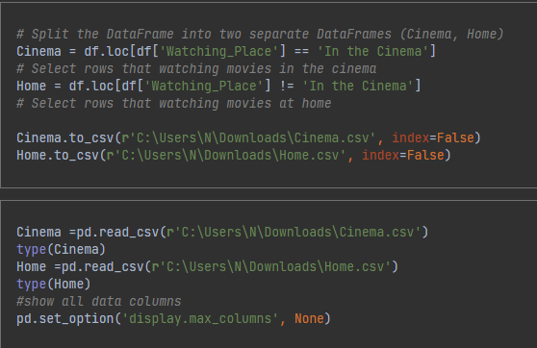
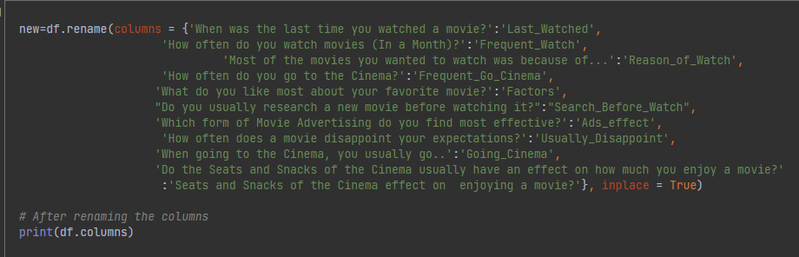
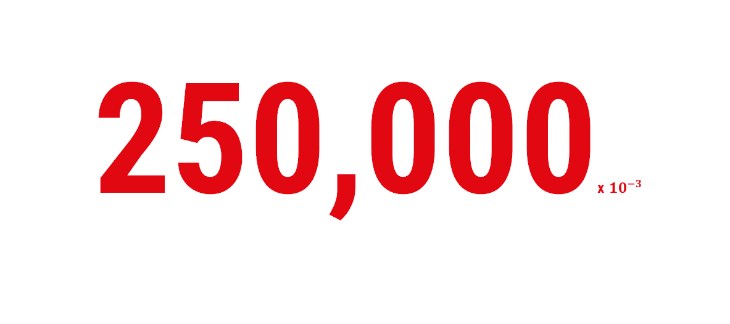
250,000x $10^{−3}$
Objectives
Home
Phase 1
Phase 2
Phase 3
Phase 4
Phase 5
Phase 6
1) We splited the data into two sections
2) Then started renaming columns:
Our audience’s attention
The objective of this phase is to obtain a clean dataset that is free from careless responses, missing values and inconsistencies while being well-framed and easy to read. As part of the data collection process, it is essential to ensure that the data obtained is clean and free from any errors or inconsistencies.

Slide 19
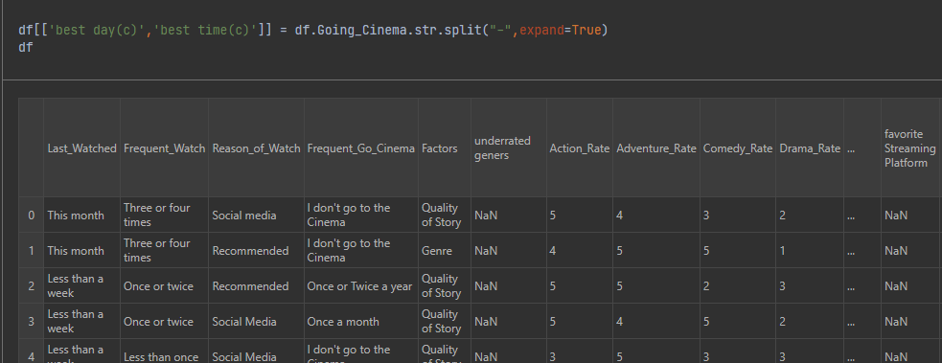
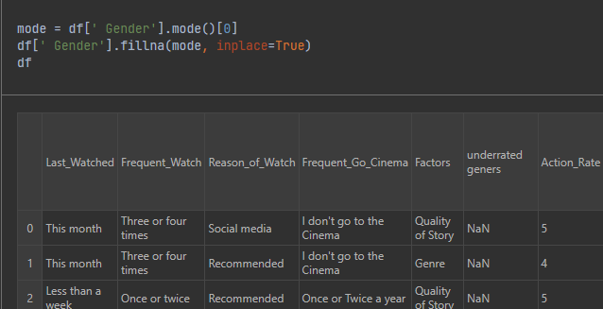
| Preparing our data
4) Fill the NAN values:
3) Also, we splited the columns:
Home
Phase 1
Phase 2
Phase 3
Phase 4
Phase 5
Phase 6
1) We splited the data into two sections
2) Then started renaming columns:

Slide 20
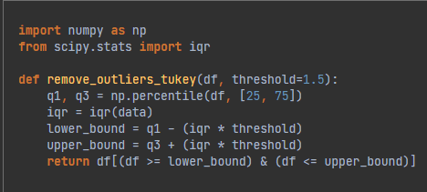
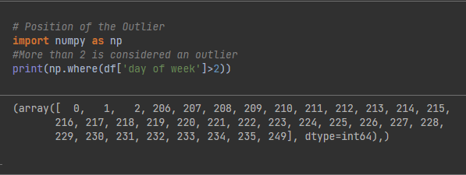
| Preparing our data
Home
Phase 1
Phase 2
Phase 3
Phase 4
Phase 5
Phase 6
5) Finally: We calculated the outliers and remove the unneeded columns:
3) Also, we splited the columns:
4) Fill the NAN values:

Slide 21
| Preparing our data
Home
Phase 1
Phase 2
Phase 3
Phase 4
Phase 5
Phase 6
5) Finally: We calculated the outliers and remove the unneeded columns:

Slide 22
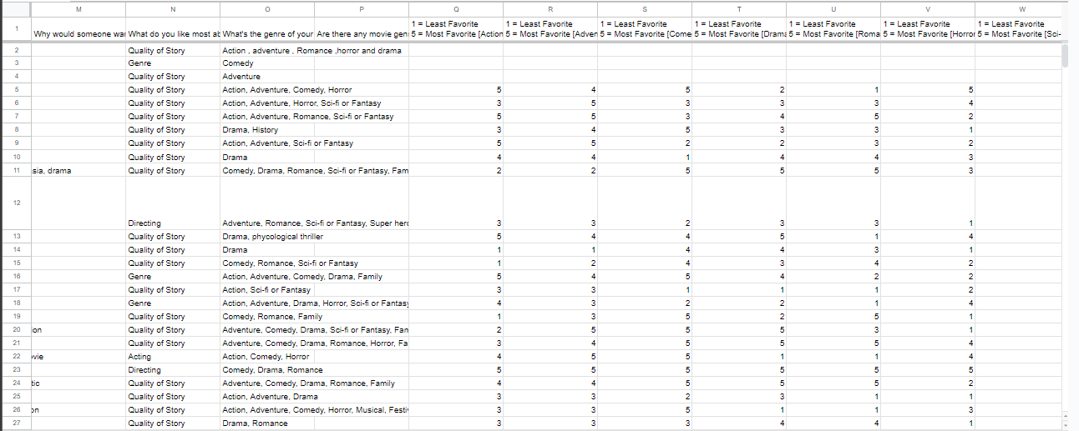
| Before cleaning
Home
Phase 1
Phase 2
Phase 3
Phase 4
Phase 5
Phase 6

Slide 23
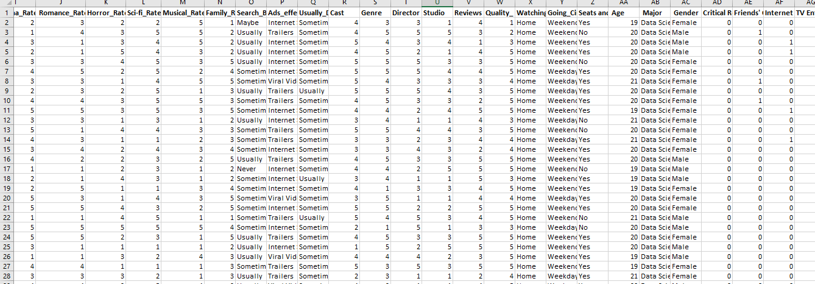
| After cleaning
Validity & Reliability
03
01
Renaming Columns
To check reliability we have used Cronbach’s alpha
This includes dividing checkboxes
Home
Phase 1
Phase 2
Phase 3
Phase 4
Phase 5
Phase 6
Pilot Testing
Test-Restest
02
04
Identifying issues before full implementation.
To check the validity of our responses, we applied this technique on sample size = 30

Slide 24
WORK PROCESS
Validity & Reliability
Renaming Columns
Pilot Testing
Test-Restest
Home
Phase 1
Phase 2
Phase 3
Phase 4
Phase 5
Phase 6
Conclusions
01
03
This includes dividing checkboxes
To check reliability we have used Cronbach’s alpha
02
04
Identifying issues before full implementation.
To check the validity of our responses, we applied this technique on sample size = 30
After applying Cronbach’s alpha and Test-Restest we have concluded that:
The highest value of alpha we have achieved is: 0.43 which is quite acceptable.
only 2 responses of our 30-sample have answered different answers between each one he had answered it, so we have achieved validity.

Slide 25
Conclusions
Home
Phase 1
Phase 2
Phase 3
Phase 4
Phase 5
Phase 6
After applying Cronbach’s alpha and Test-Restest we have concluded that:
The highest value of alpha we have achieved is: 0.803 which is acceptable.
only 2 responses of our 30-sample have answered different answers between each one he had answered it, so we have achieved validity.

Slide 26
Expectations Vs. Reality
Our Findings
Home
Phase 1
Phase 2
Phase 3
Phase 4
Phase 5
Phase 6
05
How we feel What we end up with
62.5%
37.5%
The response rate observed from the surveys
Total percentage of unanswered surveys

Slide 27


Our Findings
62.5%
37.5%
Home
Phase 1
Phase 2
Phase 3
Phase 4
Phase 5
Phase 6
Non-Answered Surveys
The response rate observed from the surveys
Total percentage of unanswered surveys
Our comprehensive analysis of the google form questionnaire indicates that 150 participants do not respond to our survey
We believe that the cause of unanswered surveys is that none of the survey respondents had a financial incentive to participate.

Slide 28
Non-Answered Surveys
Carelessness-Answered Surveys
Home
Phase 1
Phase 2
Phase 3
Phase 4
Phase 5
Phase 6
Our comprehensive analysis of the google form questionnaire indicates that 150 participants do not respond to our survey
We believe that the cause of unanswered surveys is that none of the survey respondents had a financial incentive to participate.
Survey responses that show symptoms of inattention or a lack of effort from the participants are referred to as carelessly answered surveys.
These responses could be answering all questions with the same response option, giving answers that are illogical or contradictory, or purposefully failing attention check questions.
We designed attention check questions that ensure the respondent’s attentiveness and the integrity of their responses.

Slide 29
Carelessness-Answered Surveys
Home
Phase 1
Phase 2
Phase 3
Phase 4
Phase 5
Phase 6
Survey responses that show symptoms of inattention or a lack of effort from the participants are referred to as carelessly answered surveys.
These responses could be answering all questions with the same response option, giving answers that are illogical or contradictory, or purposefully failing attention check questions.
We designed attention check questions that ensure the respondent’s attentiveness and the integrity of their responses.

Slide 30
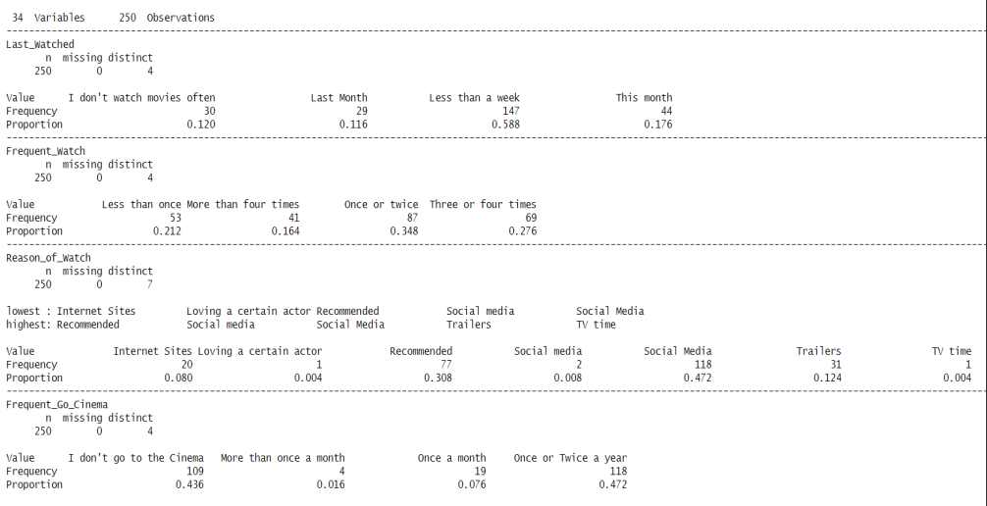
Data Analysis
Descriptive Statistics:
Home
Phase 1
Phase 2
Phase 3
Phase 4
Phase 5
Phase 6
06
Statistical analysis: Chi square and Regression models

Slide 31
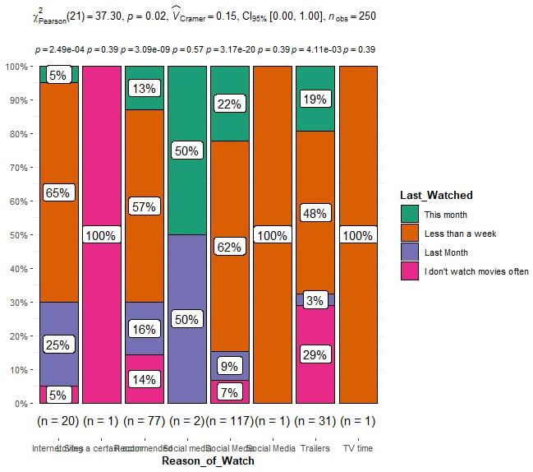
Descriptive Statistics:
Chi-Square
Home
Phase 1
Phase 2
Phase 3
Phase 4
Phase 5
Phase 6
we conclude that those two columns are dependent on each other.

Slide 32
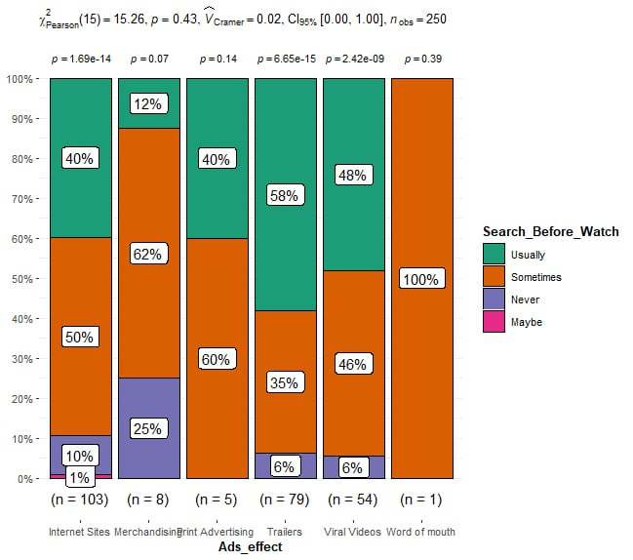
Chi-Square
Home
Phase 1
Phase 2
Phase 3
Phase 4
Phase 5
Phase 6
Chi-Square
we conclude that those two columns are independent of each other.
we conclude that those two columns are dependent on each other.

Slide 33
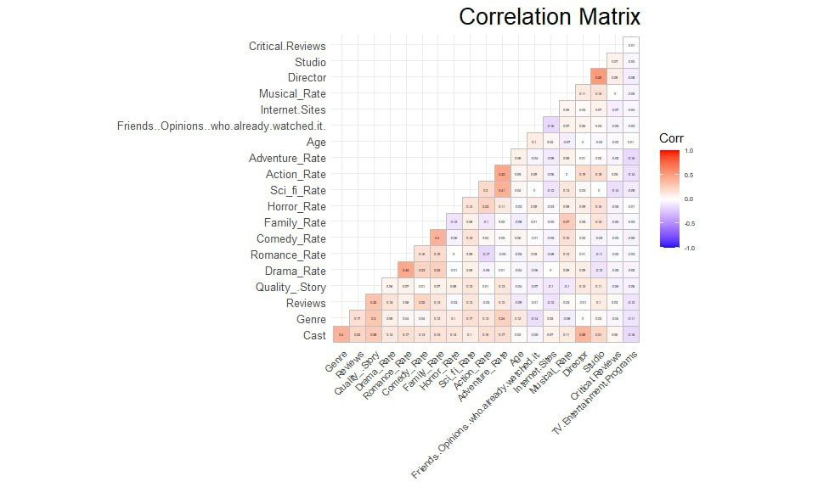
Chi-Square
Find Correlation:
Find Correlation:
Home
Phase 1
Phase 2
Phase 3
Phase 4
Phase 5
Phase 6
Our correlation matrix shows which values are dependent on each other.
we conclude that those two columns are independent of each other.

Slide 34
Find Correlation:
Home
Phase 1
Phase 2
Phase 3
Phase 4
Phase 5
Phase 6
Our correlation matrix shows which values are dependent on each other.

Slide 35
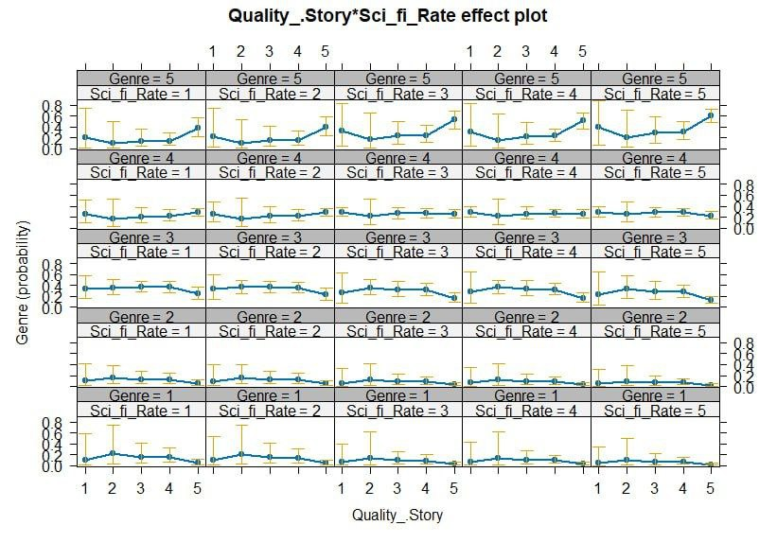
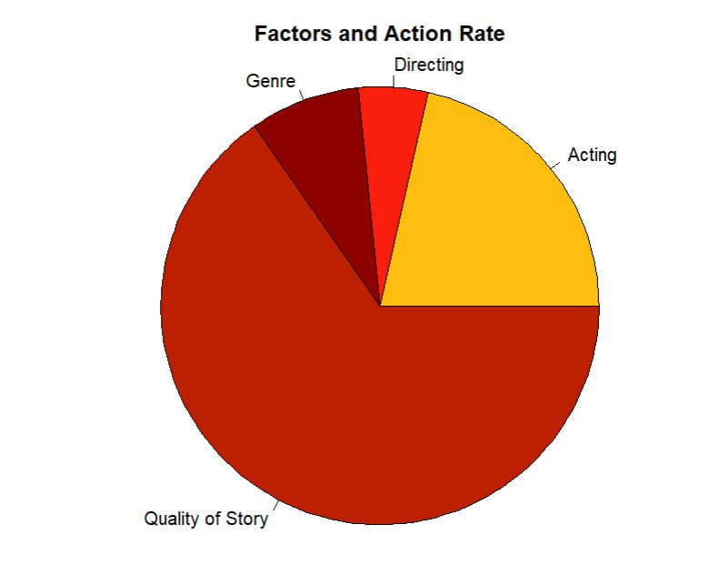
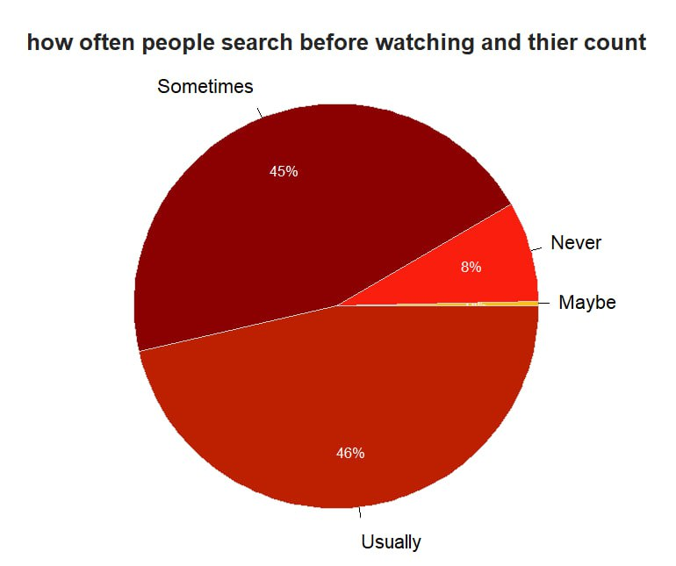
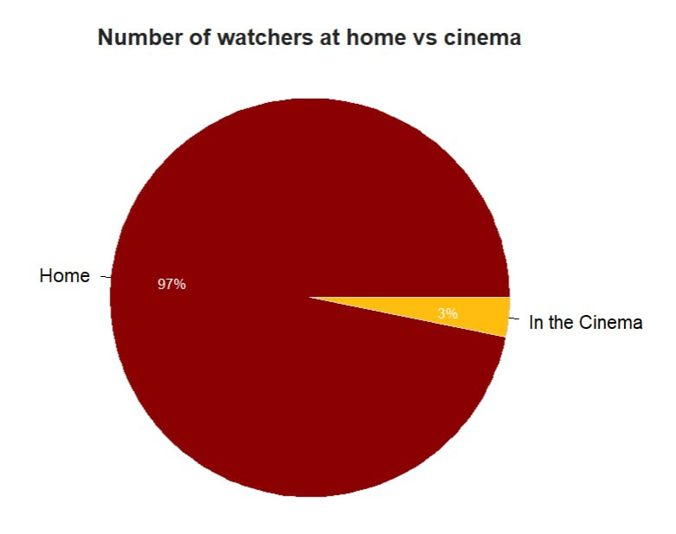
Regression Analysis
Home
Phase 1
Phase 2
Phase 3
Phase 4
Phase 5
Phase 6
we see the effect of the independent sci-fi rate on genre and its probability

Slide 36
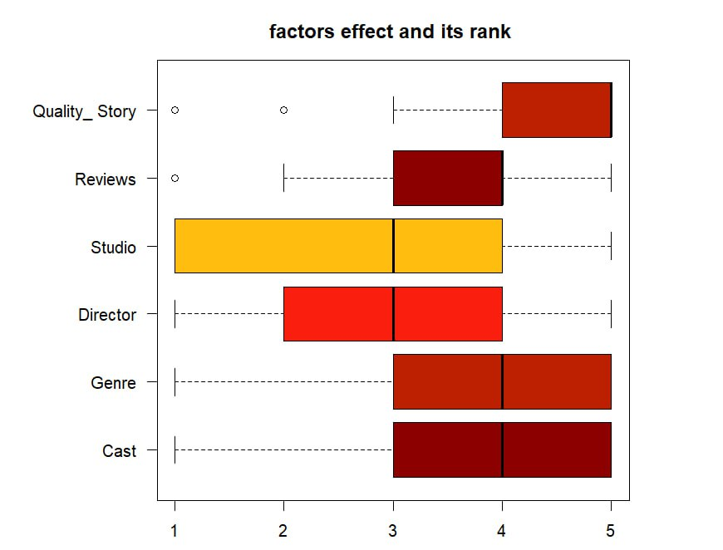
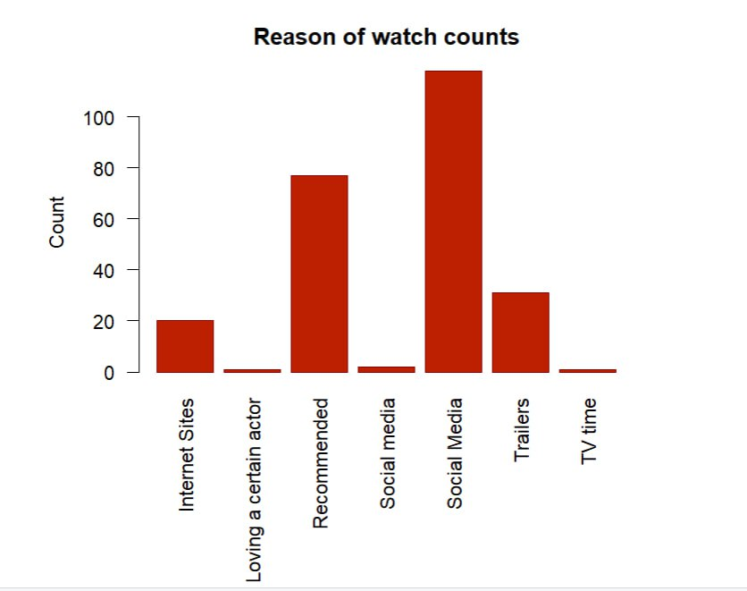
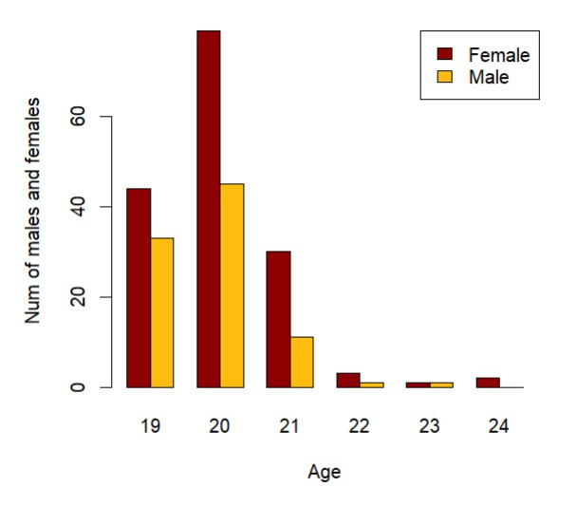
Visualizing some important data
Home
Phase 1
Phase 2
Phase 3
Phase 4
Phase 5
Phase 6

Slide 37
Visualizing some important data
Home
Phase 1
Phase 2
Phase 3
Phase 4
Phase 5
Phase 6

Slide 38
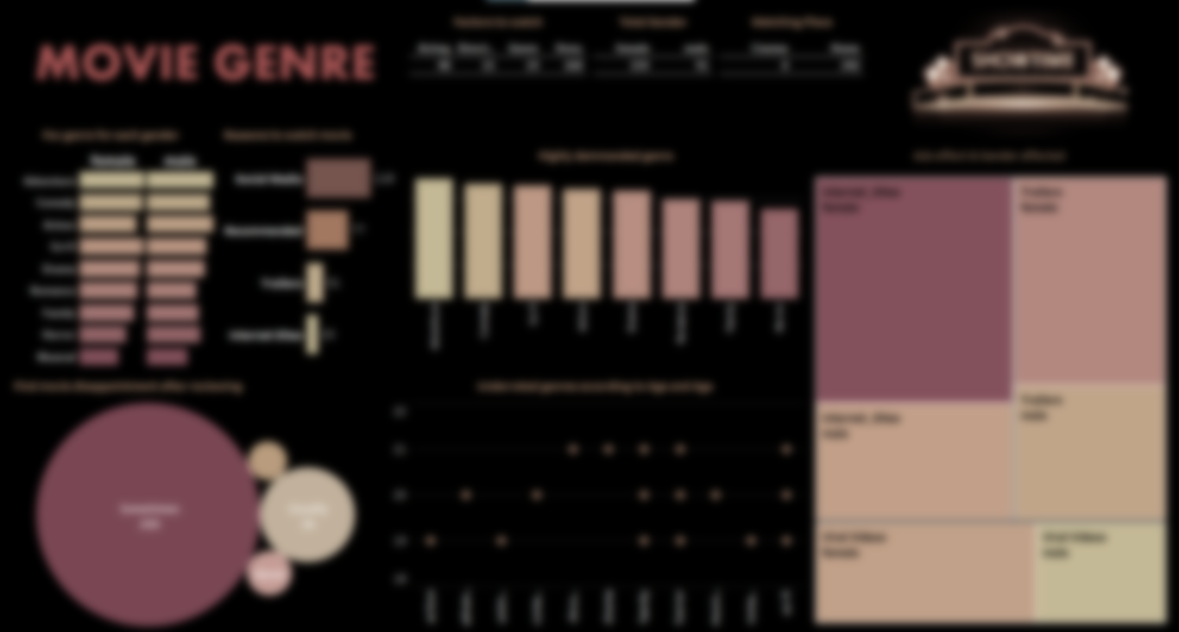
Meet our Tableau Dashboard
Home
Phase 1
Phase 2
Phase 3
Phase 4
Phase 5
Phase 6

Slide 39
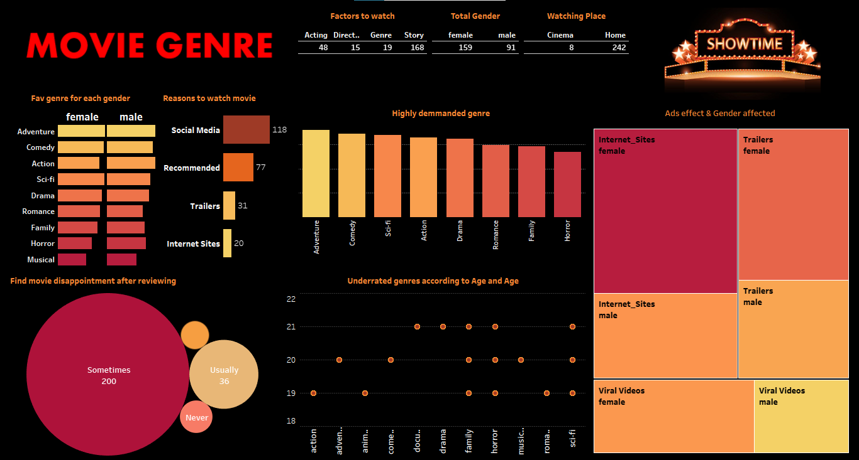

Slide 40
THANKS!
Home
Phase 1
Phase 2
Phase 3
Phase 4
Phase 5
Phase 6
Do you have any questions?

